Slide 1


Analyzing Twitter Population Behavior based on Timberwolves’ Wins and Losses
Group 11: Beepa Bose. Jingwen(Echo) Pei, Lakshya Garg, Prachi Sharma, Zhanglin Shangguan, Zhaoyan Zhi

Slide 2



Problem Statement & Use Case
Track population sentiment post Timberwolves wins & losses
Help advertisement investor to determine whether to sponsor the team and if yes then at what time.
Estimate merchandise sale by tracking sentiment
Notes:
Need to further complete the sentence

Slide 3



The Vs of Big Data
Volume: Twitter gets millions of tweets daily generating more than 12 terabytes daily
Variety : text, emoticons, images etc
Veracity: A lot of words that don’t carry any contextual meaning
Notes:
1. scalable storage 2. easily accessible 3. run analytics at high frequency 4. provides mixture of IaaS, PaaS and SaaS

Slide 4
Data Description
Columns:
Twitter handle
Captures the handle from which the tweet was scraped from
Tweet text
Captures the tweet text data
Date time
Captures the date and time on which the tweet was posted
Sentiment
Associated a sentiment to each tweet based in the tweet text
*only the playoffs data is leveraged with timberwolves having the match between the same team.
Notes:
1. scalable storage 2. easily accessible 3. run analytics at high frequency 4. provides mixture of IaaS, PaaS and SaaS

Slide 5






Roadmap
Data Source
Twitter API
Data Cleaning
Sentiment Analysis
Correlation Analysis
NLP
Storing Historical Data
Notes:
1. Scrape relevant data from twitter handles leveraging python 2. Conduct sentiment analysis on each tweet 3. Store the data into S3 () 4. Find correlation between the Timberwolves' wins and the number of positive tweets

Slide 6
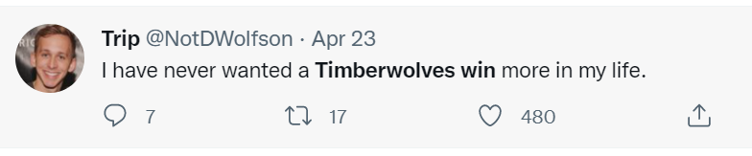




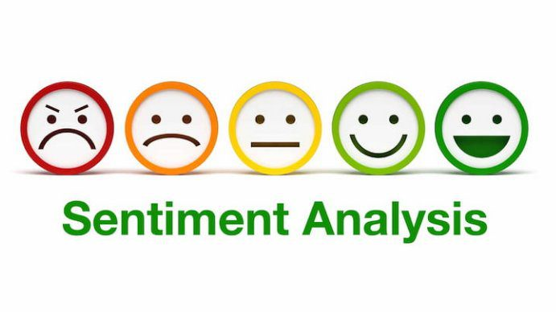
Sentiment Analysis
Storing to S3 Bucket
Setting Twitter Handle
Assigning the sentiment to each tweet

Slide 7



Analyzing Correlation
The game outcome had a significant impact on the sentiments of the tweets (1)
Interesting finding:
The average sentiment of positive tweets before a game is positively and strongly correlated with the upcoming game score! (Correlation coef 0.77)
Note: (1)The probability of the game outcome not impacting the sentiments of tweets is as low as 2e-16. hence, we can conclude that the game outcome has a significant impact on the tweet sentiment(positive, negative, neutral).
Notes:
Corr Coef : 0.667
step 1: two way table
step 2:

Slide 8
Conclusion
The number of positive tweets that stay until 2 days after a Timberwolves game has a very high correlation with
The number of points that Timberwolves score (0.85)
The number of assists (0.74)
The number of rebounds (0.71)
The number of positive tweets that stay until 2 days after a Timberwolves game has a very low correlation with
The number of blocks(0.13)
The number of steals(0.17)
Notes:
Beepa
3-pointers
blocks
steals

Slide 9
Recommendations
For investors looking for teams to sponsor, they can attach greater importance to those segments that have higher correlation with the positive tweets and ignore those less related ones;
For merchandisers, they can highlight more theme-related products in center positions following the priority indicated by the correlation scores.

Slide 10



Other Applications
The combination of sentiment analysis and correlation analysis can be extended to other cases:
analyze public sentiment of some types of policies
analyze customer sentiment to various marketing campaign
predict public reaction to social current affairs
Notes:
This analysis allows us to quantify the sentiment of the Timberwolves fans based on the NBA games that Timberwolves win or lose. This system can be extended to quantify and analyze the behavior of the population on a new public policy or a major event.

Slide 11


